Slide 1


Alleviating the cold-start problem in
adaptive fact learning using Bayesian modelling
Maarten van der Velde, Florian Sense, Jelmer Borst, & Hedderik van Rijn
@mavdvelde

Slide 2
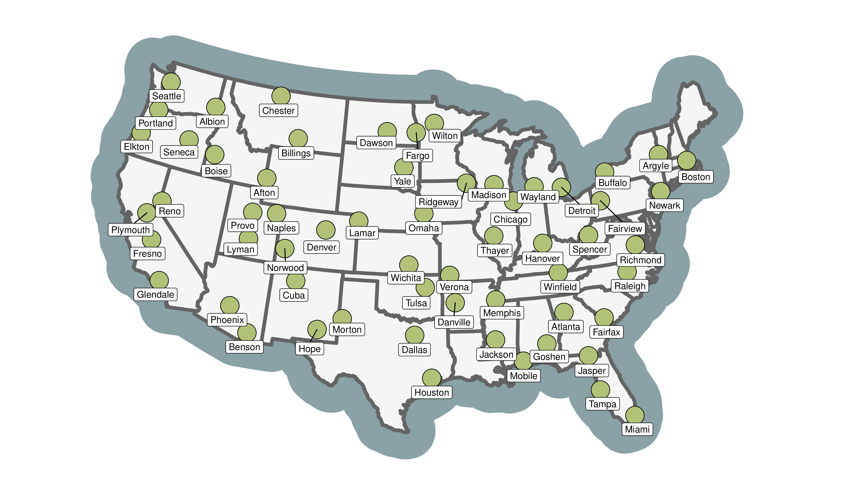

Slide 3
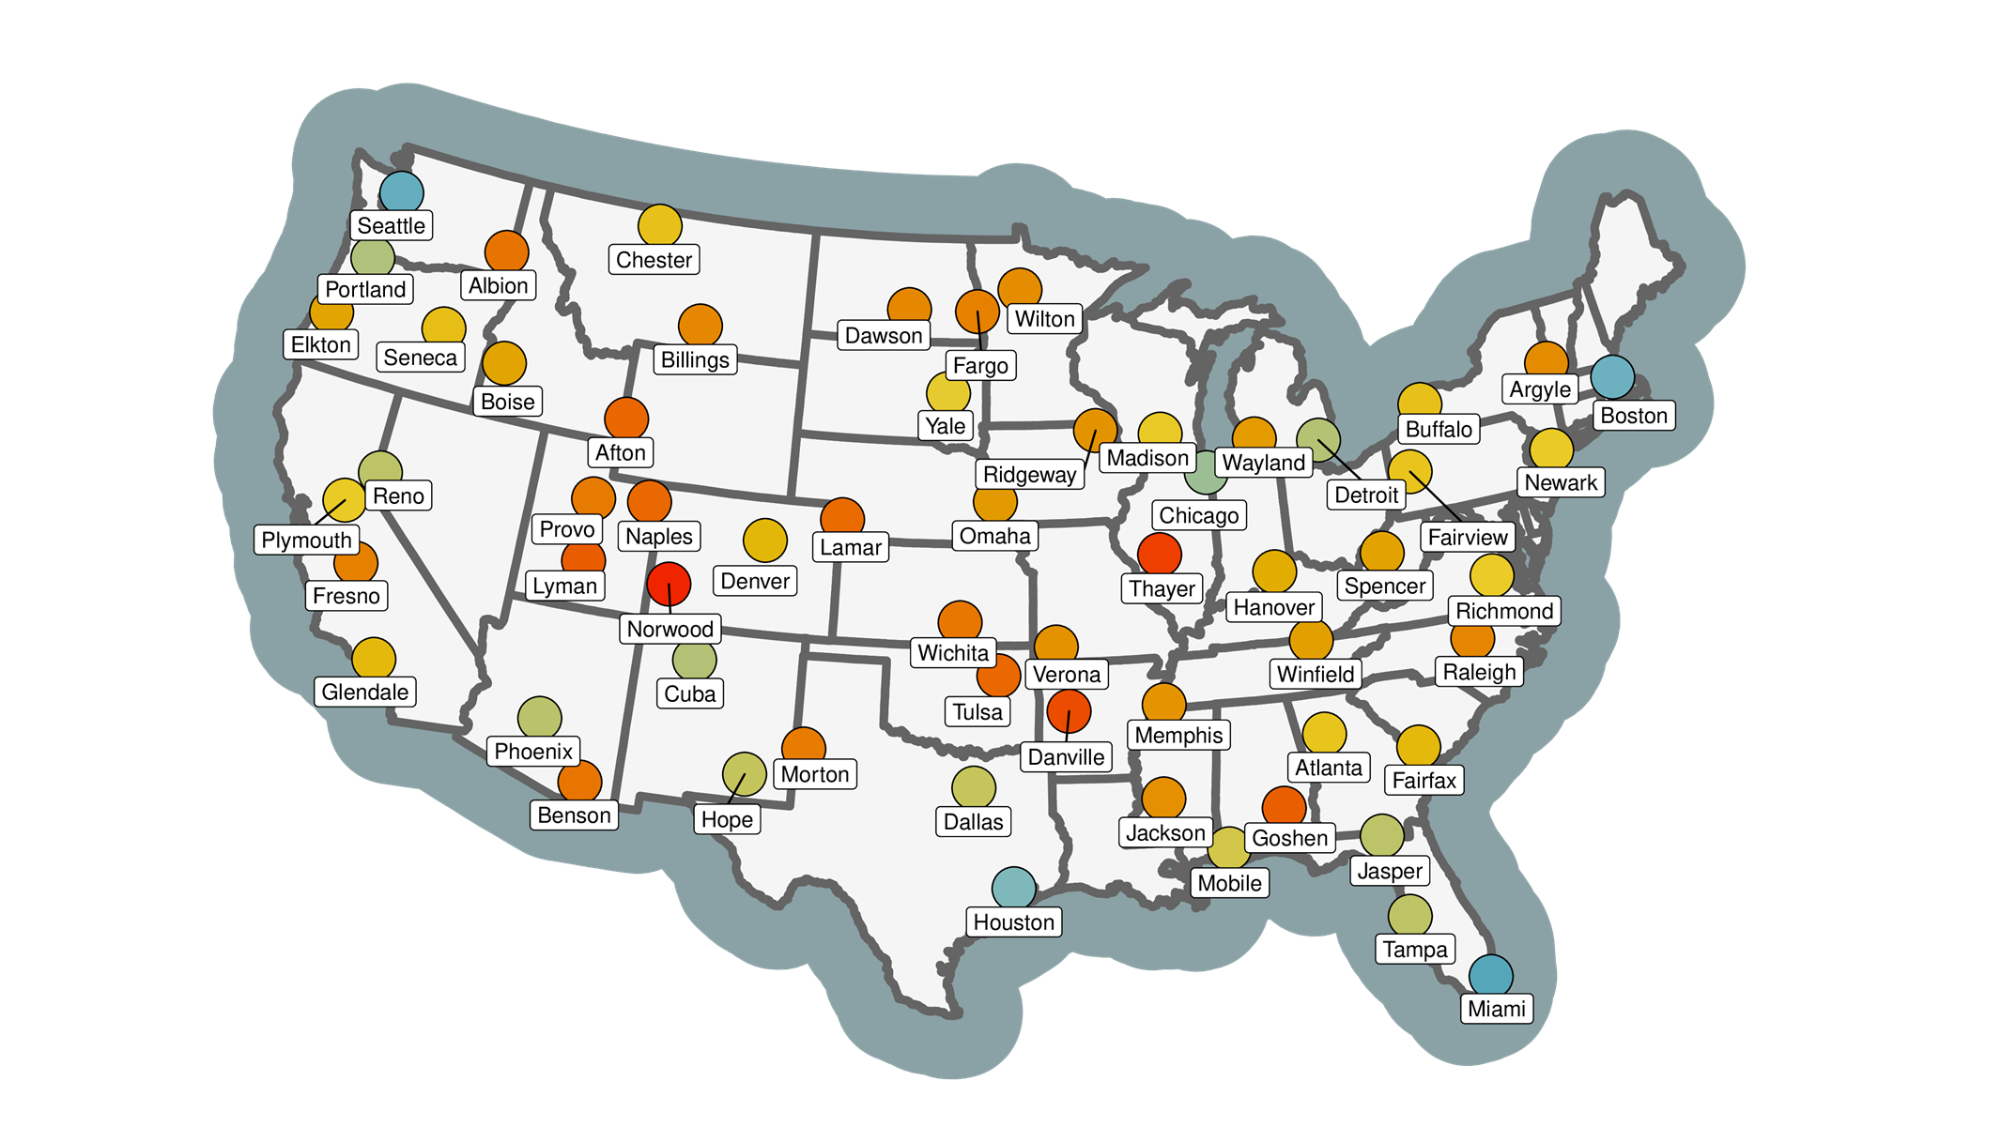

Slide 4
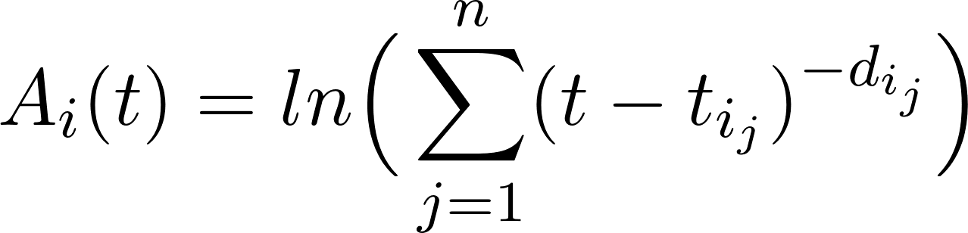
Facts are modelled as memory chunks
Anderson (2007)

Slide 5
Rehearse each item just before it’s forgotten
Forgetting threshold

Slide 7
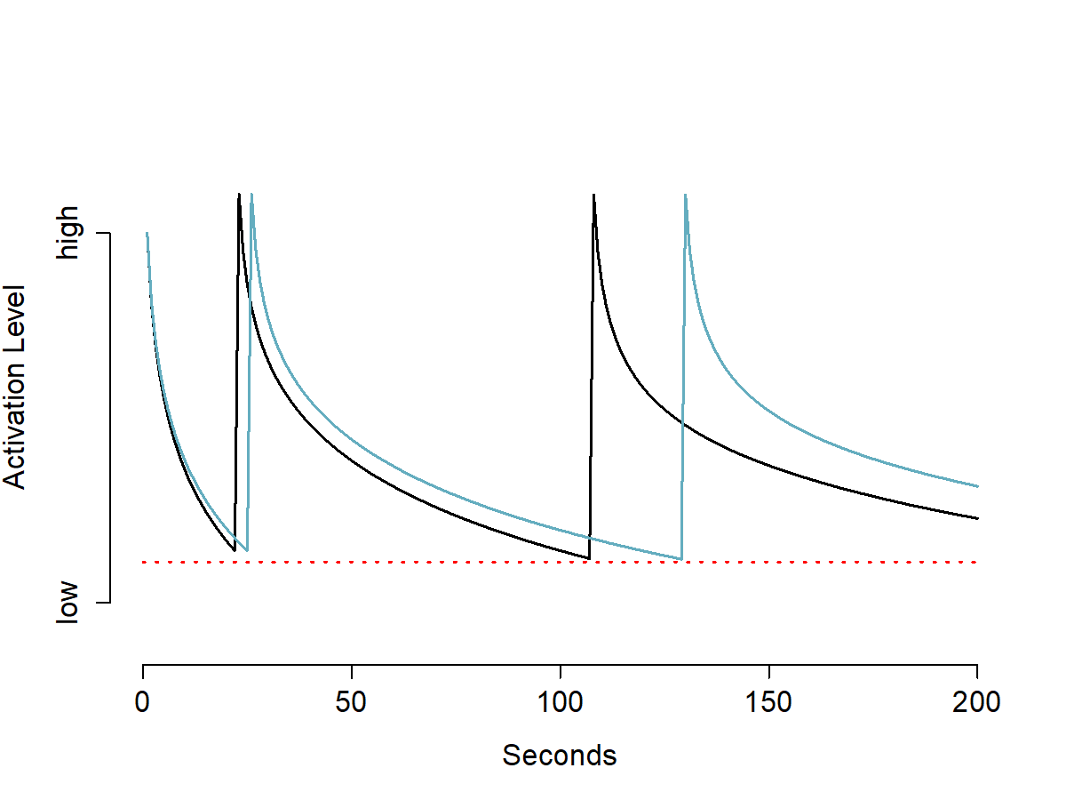
Spacing is determined by Rate of Forgetting
RoF = 0.25 (easier)
RoF = 0.35 (harder)

Slide 8
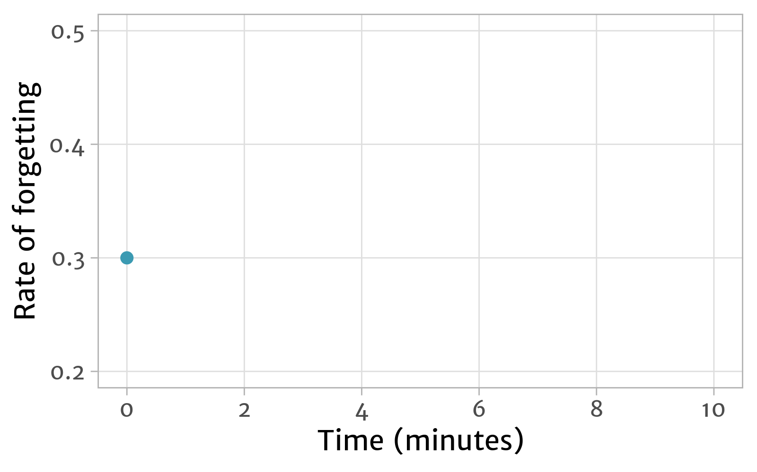
Estimating rate of forgetting
difficult
easy

Slide 9
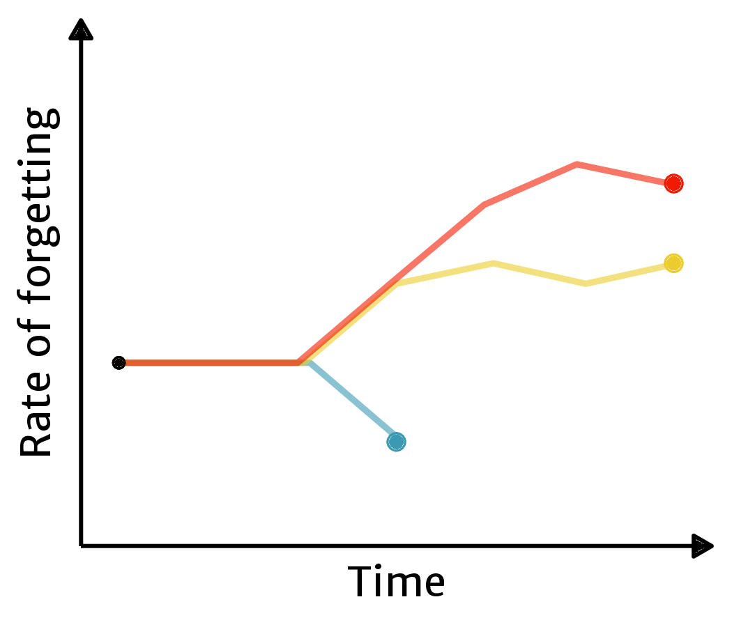
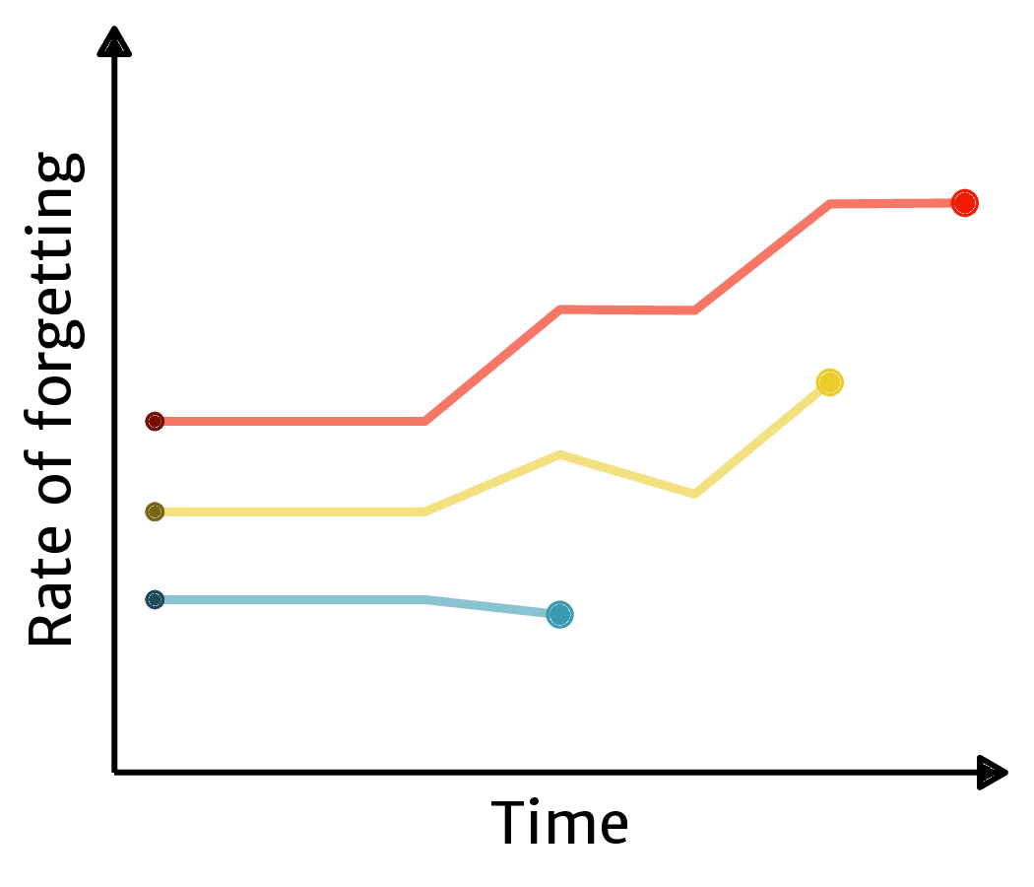

The cold-start problem
Our solution:
informed starting estimates

Slide 10
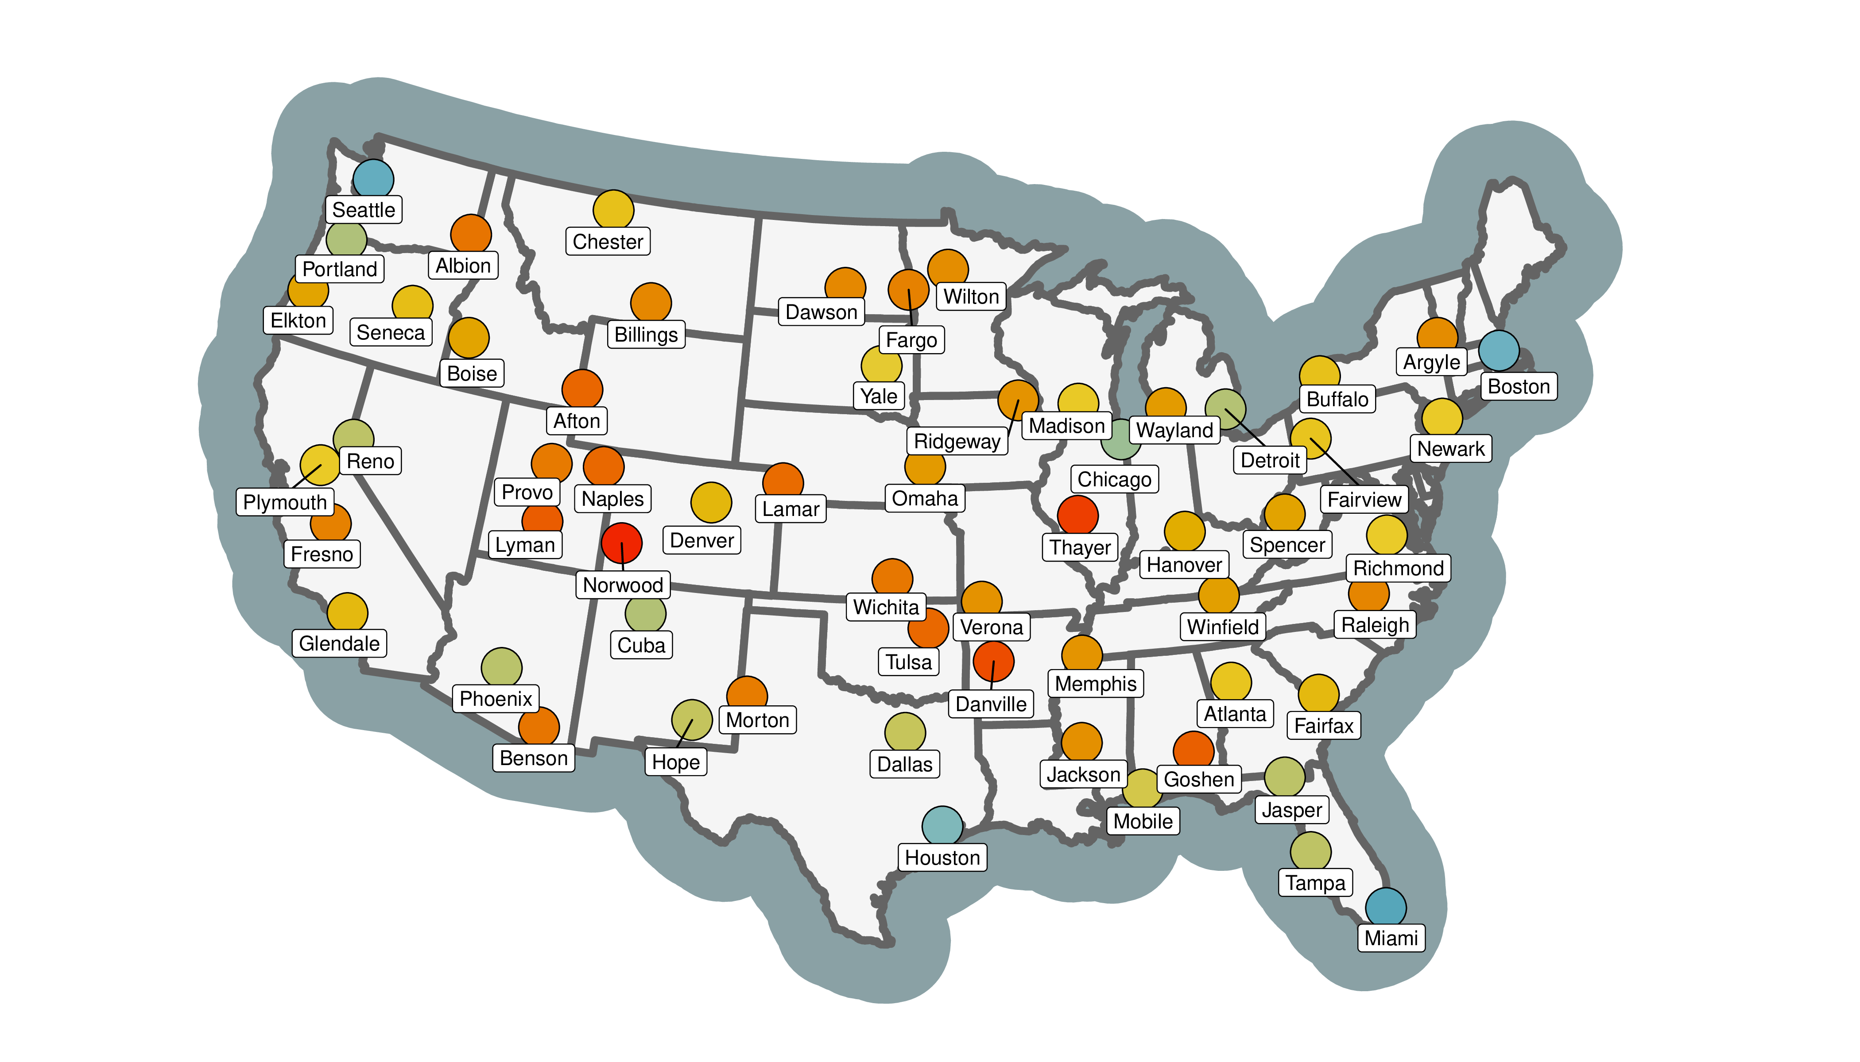
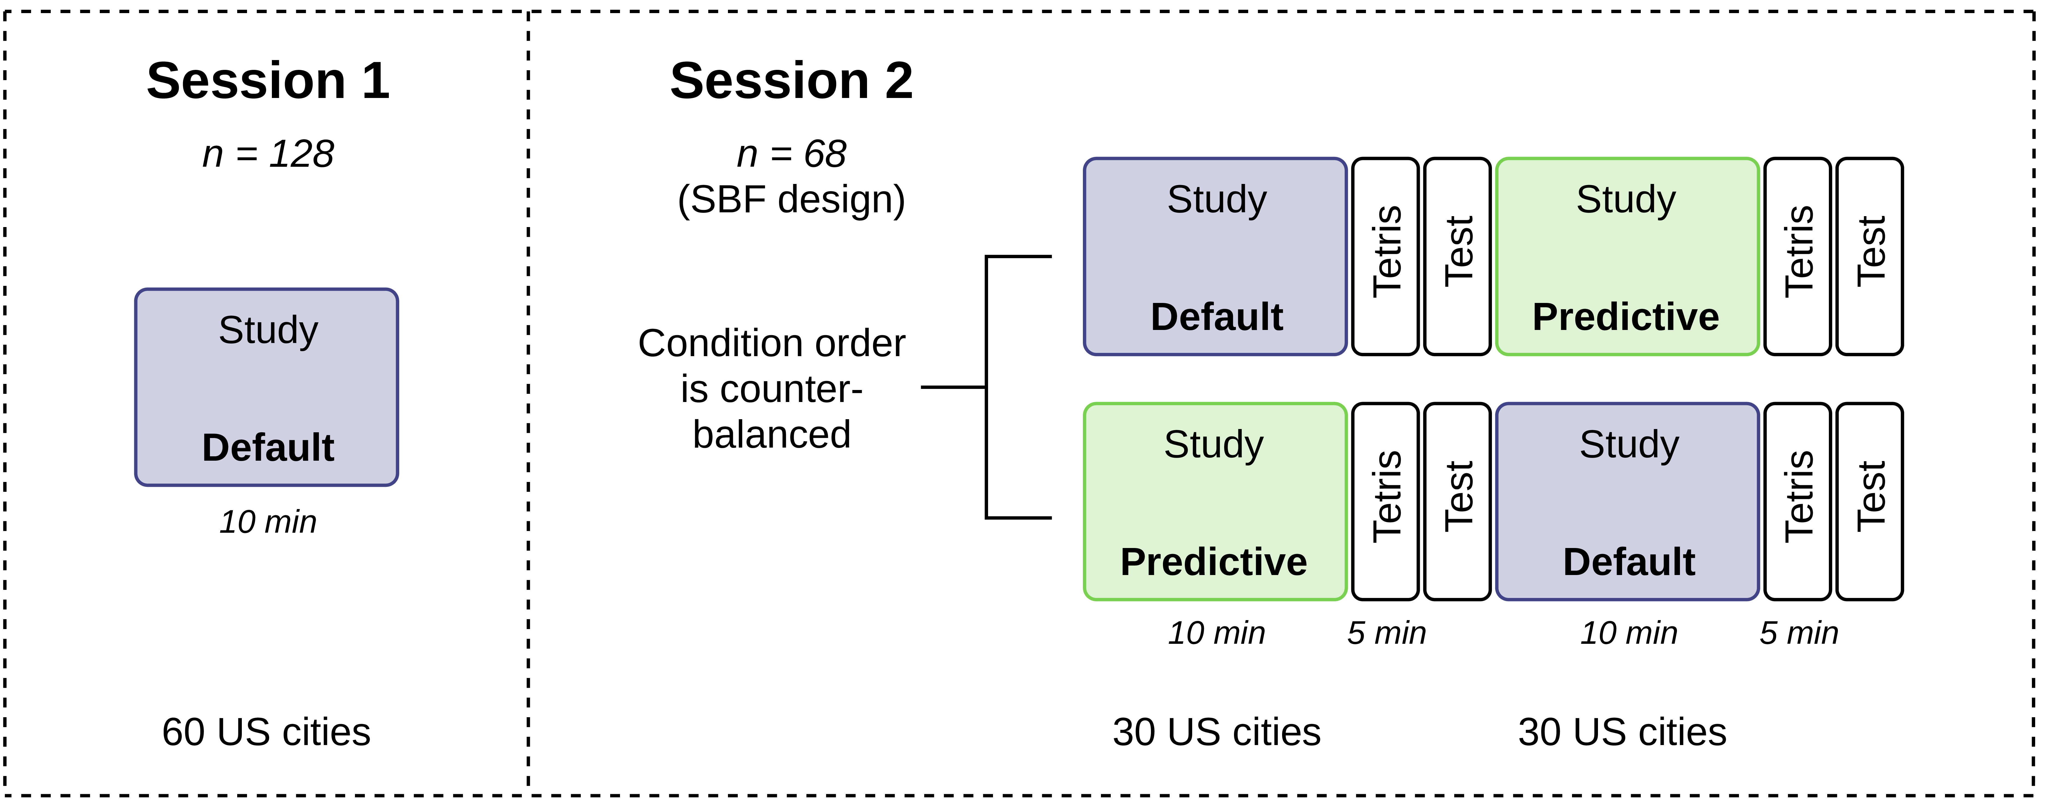

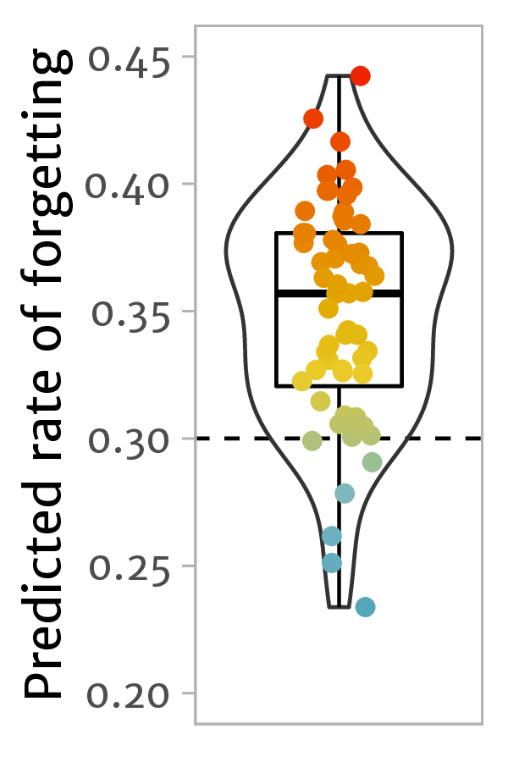
Experiment: do informed starting estimates improve retention of studied items?
Preregistration: osf.io/w4gtd

Slide 11

Experiment: do informed starting estimates improve retention of studied items?
Preregistration: osf.io/w4gtd

Slide 12
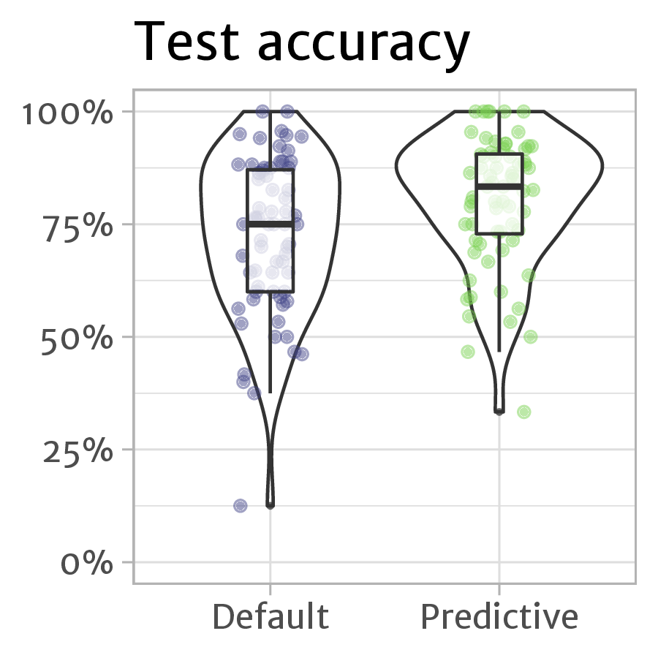
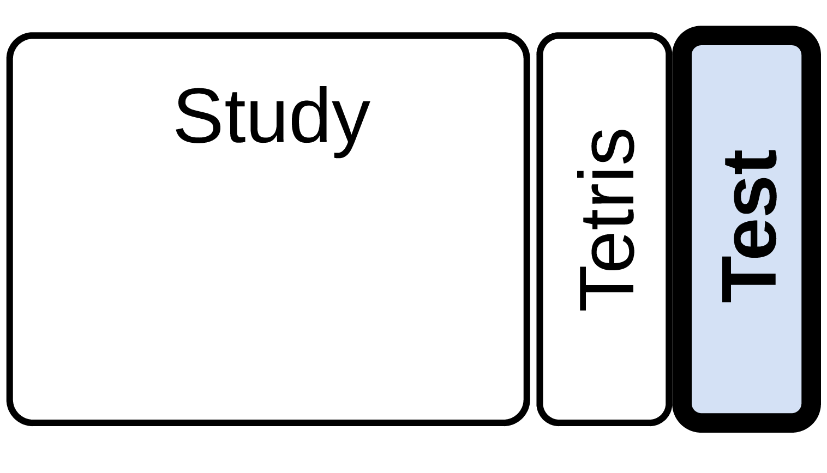
Do informed starting estimates improve retention of studied items?
Yes!
Improvement:
+6.9 pp (95% CI: [2.9, 9.7])
BF₁₀ = 181.9
/
/

Slide 13
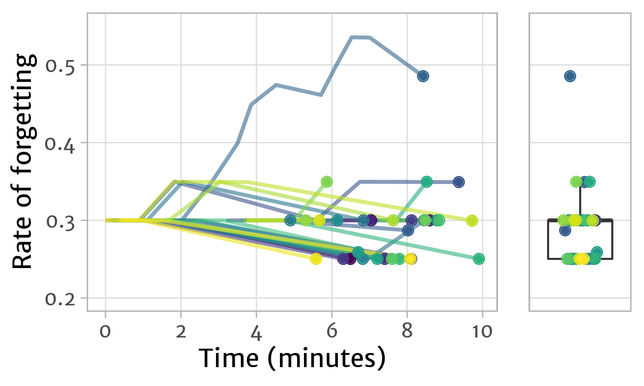
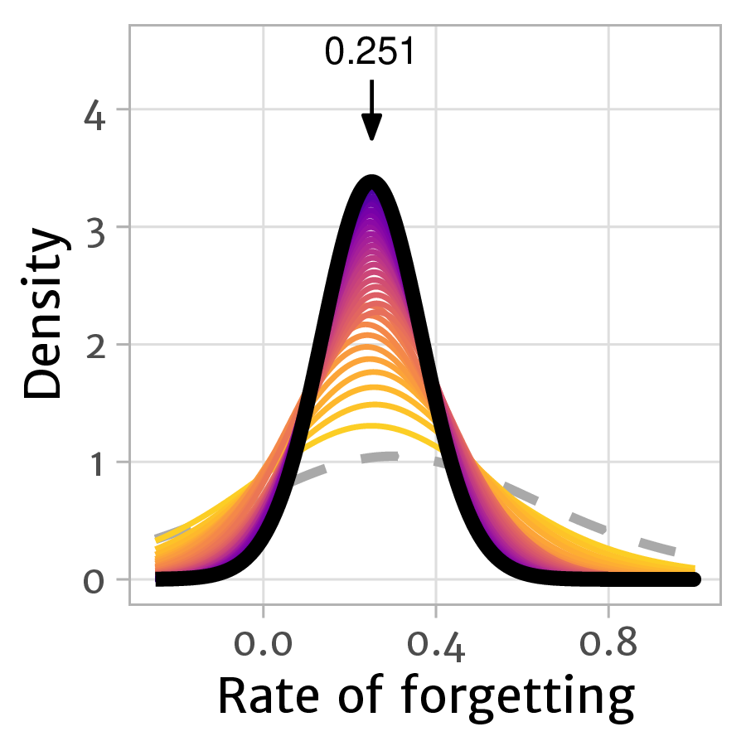

Predicting item difficulty for Session 2
Session 1 observations (all participants)
Bayesian posterior prediction
Prior:$NG\left(μ=0.3, κ=3, a=1, b=0.2\right)$

Slide 14
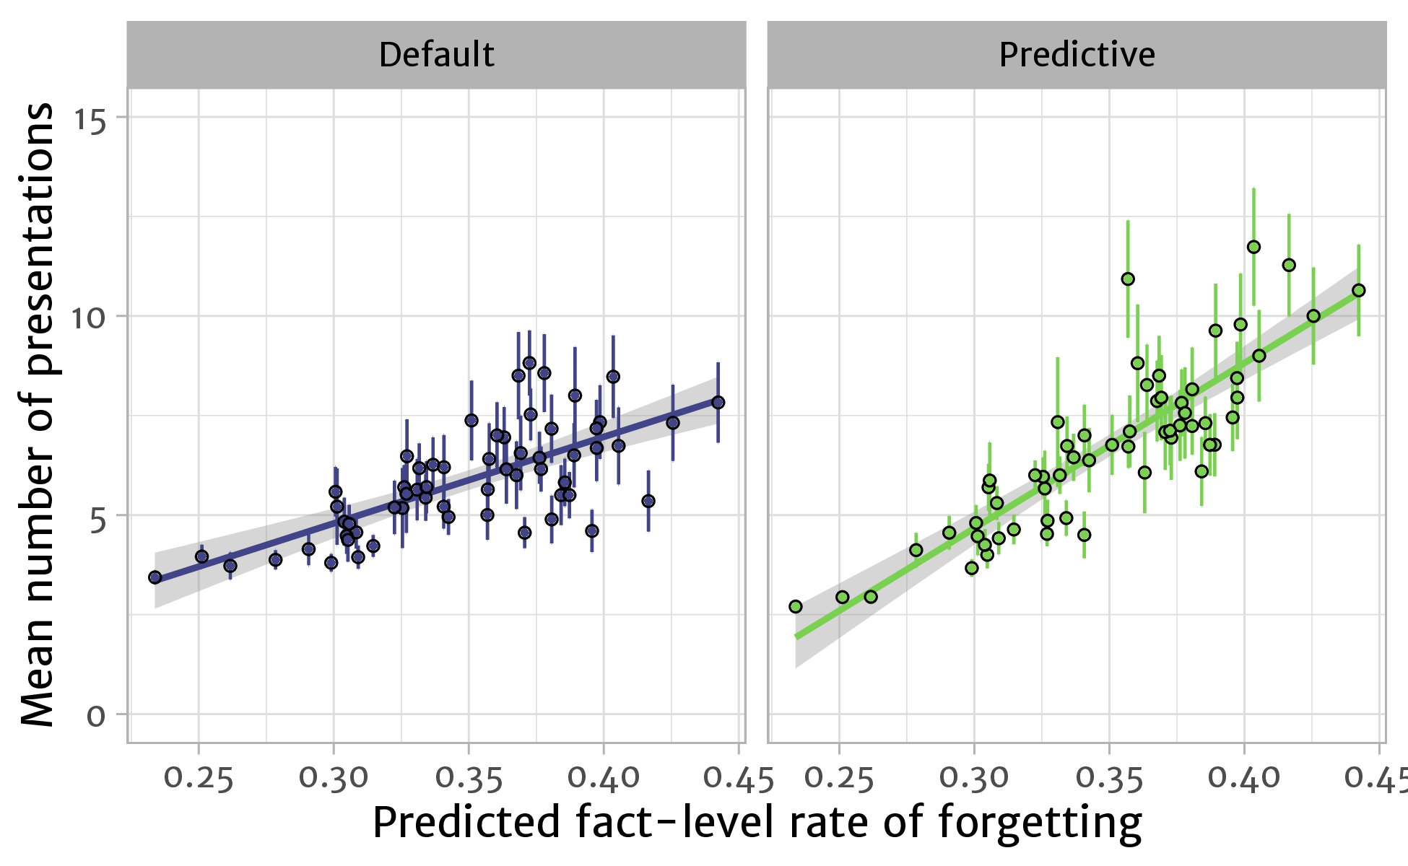
Stronger differentiation in repetition schedule

Slide 15



Alleviating the cold-start problem in
adaptive fact learning using Bayesian modelling
By using data-driven
starting estimates…
… we can allocate study
time more effectively…
… leading to improved
retention of studied items.
Maarten van der Velde, Florian Sense, Jelmer Borst, & Hedderik van Rijn
@mavdvelde

