Slide 1
Modelling Rumination
Understanding the Cognitive Mechanisms of Mind-Wandering in the Depressed Mind
Maarten van der Velde & Marieke van Vugt University of Groningen

Slide 2
Mind-wandering Rumination

Slide 3
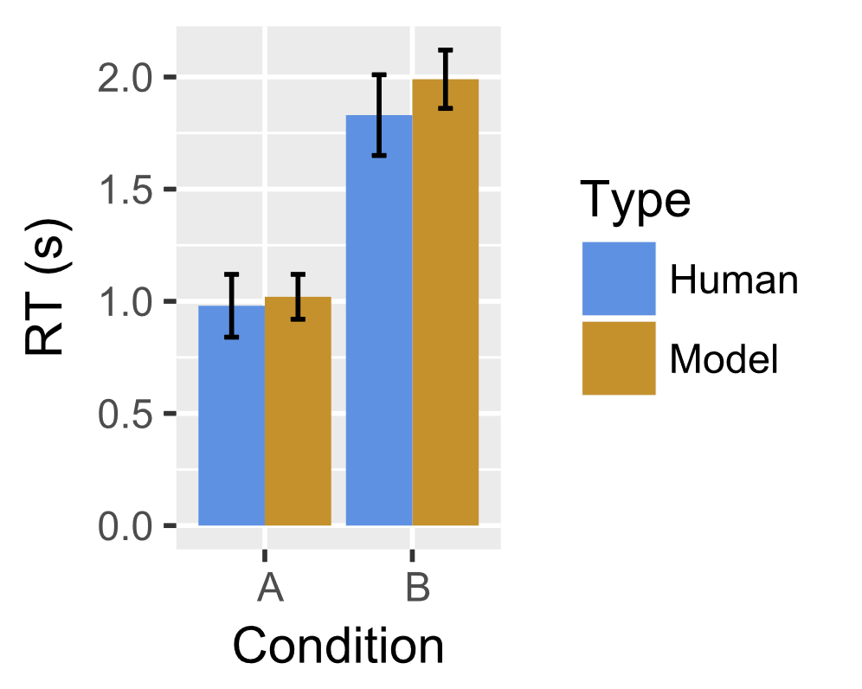
Modelling mind-wandering van Vugt, Taatgen, Sackur, Bastian (2015)
Cognitive model with mind-wandering as a competing goal
Working memory
item6 item10
item3 item12
item4 item9 item2
item1
item7 item5
item8 item11
Goals
Long-term memory
Procedural
Vision
Manual
ACT-R architecture

Slide 4
Modelling rumination van Vugt, van der Velde, & ESM-MERGE Investigators (2017)
Model
Humans experience sampling data (Wigman et al., 2015)

Slide 5
Modelling rumination: Predicting go/no-go task performance van Vugt, van der Velde, & ESM-MERGE Investigators (2017)
7
3

Slide 6
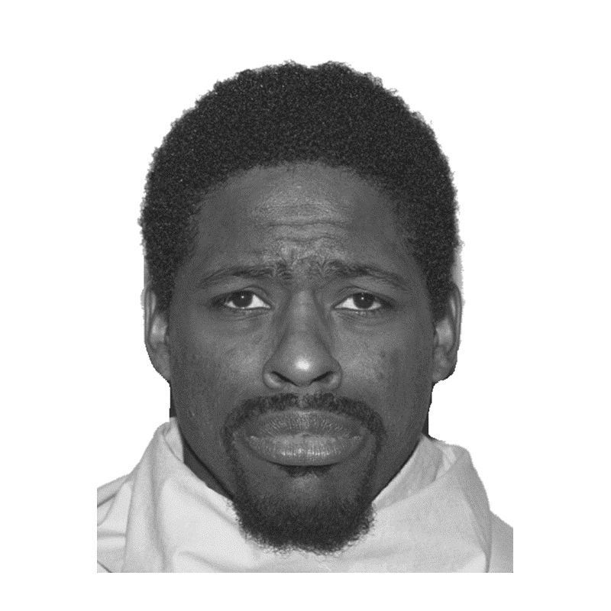
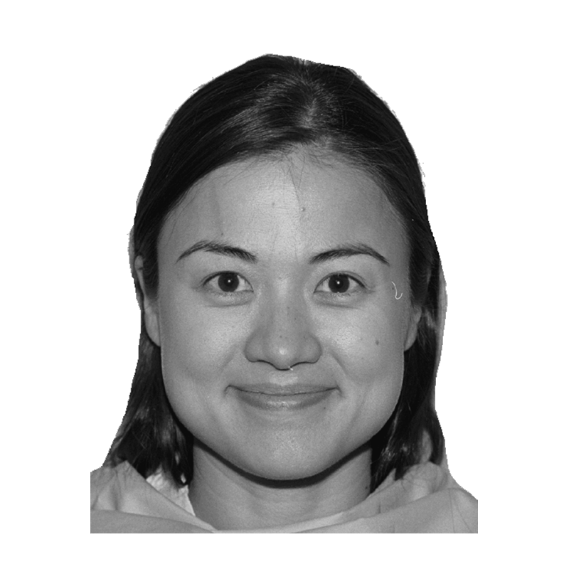
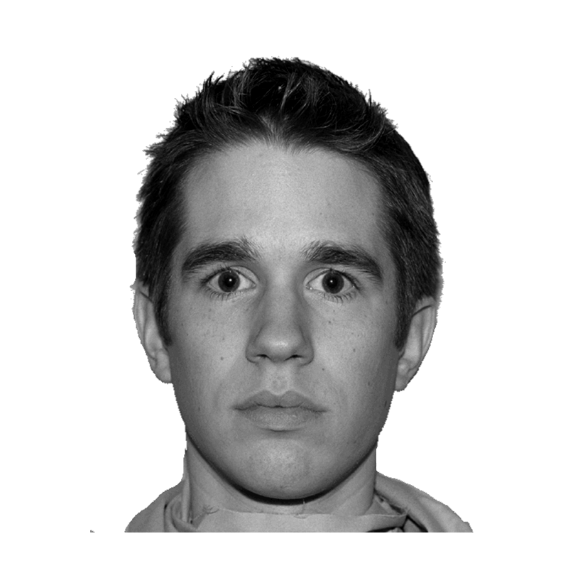
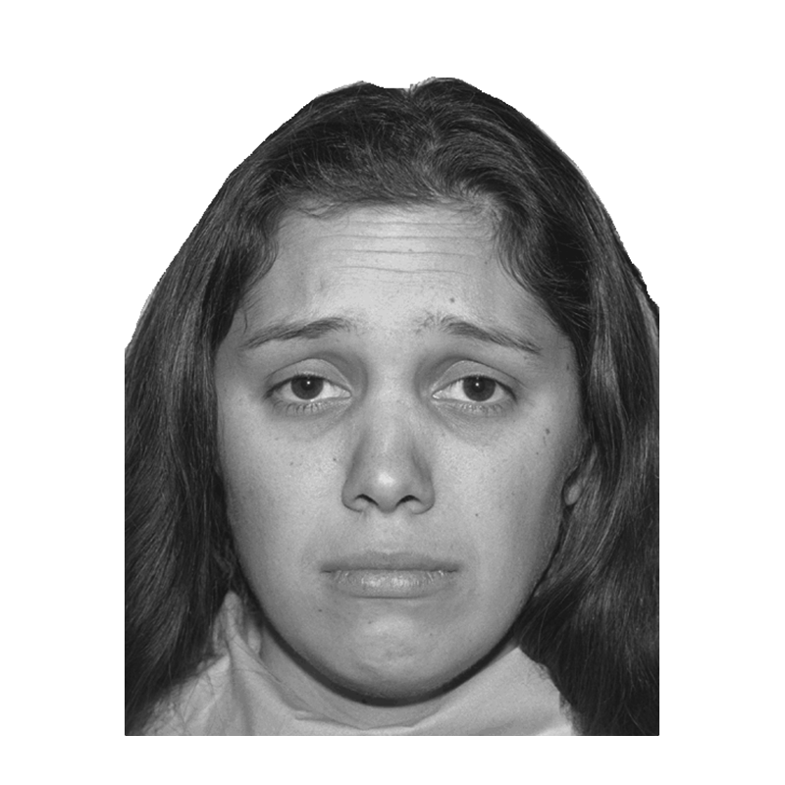
What about a more complex task? Levens & Gotlib (2010): Updating positive and negative stimuli in WM
Emotional n-back task
+

Slide 7
Emotional 2-back Levens & Gotlib (2010)
n
n + 1
n + 2 same
n + 3 different
n + 4 different

Slide 8
2-back model
?
declarative memory
expression: sad
0-back | 1-back | 2-back
0-back | 1-back | 2-back
sad | happy | sad
happy
sad
sad
neutral
match
press same

Slide 9
Emotional 0-back Levens & Gotlib (2010)
target: neutral
different
different
different
same
different

Slide 10
Effects of depression on performance Levens & Gotlib (2010)
No perceptual processing impairment (0-back)
Slower disengagement from mood-congruent items (both groups!)
elaborate
0-back | 1-back | 2-back
happy
neutral
sad
neutral

Slide 11
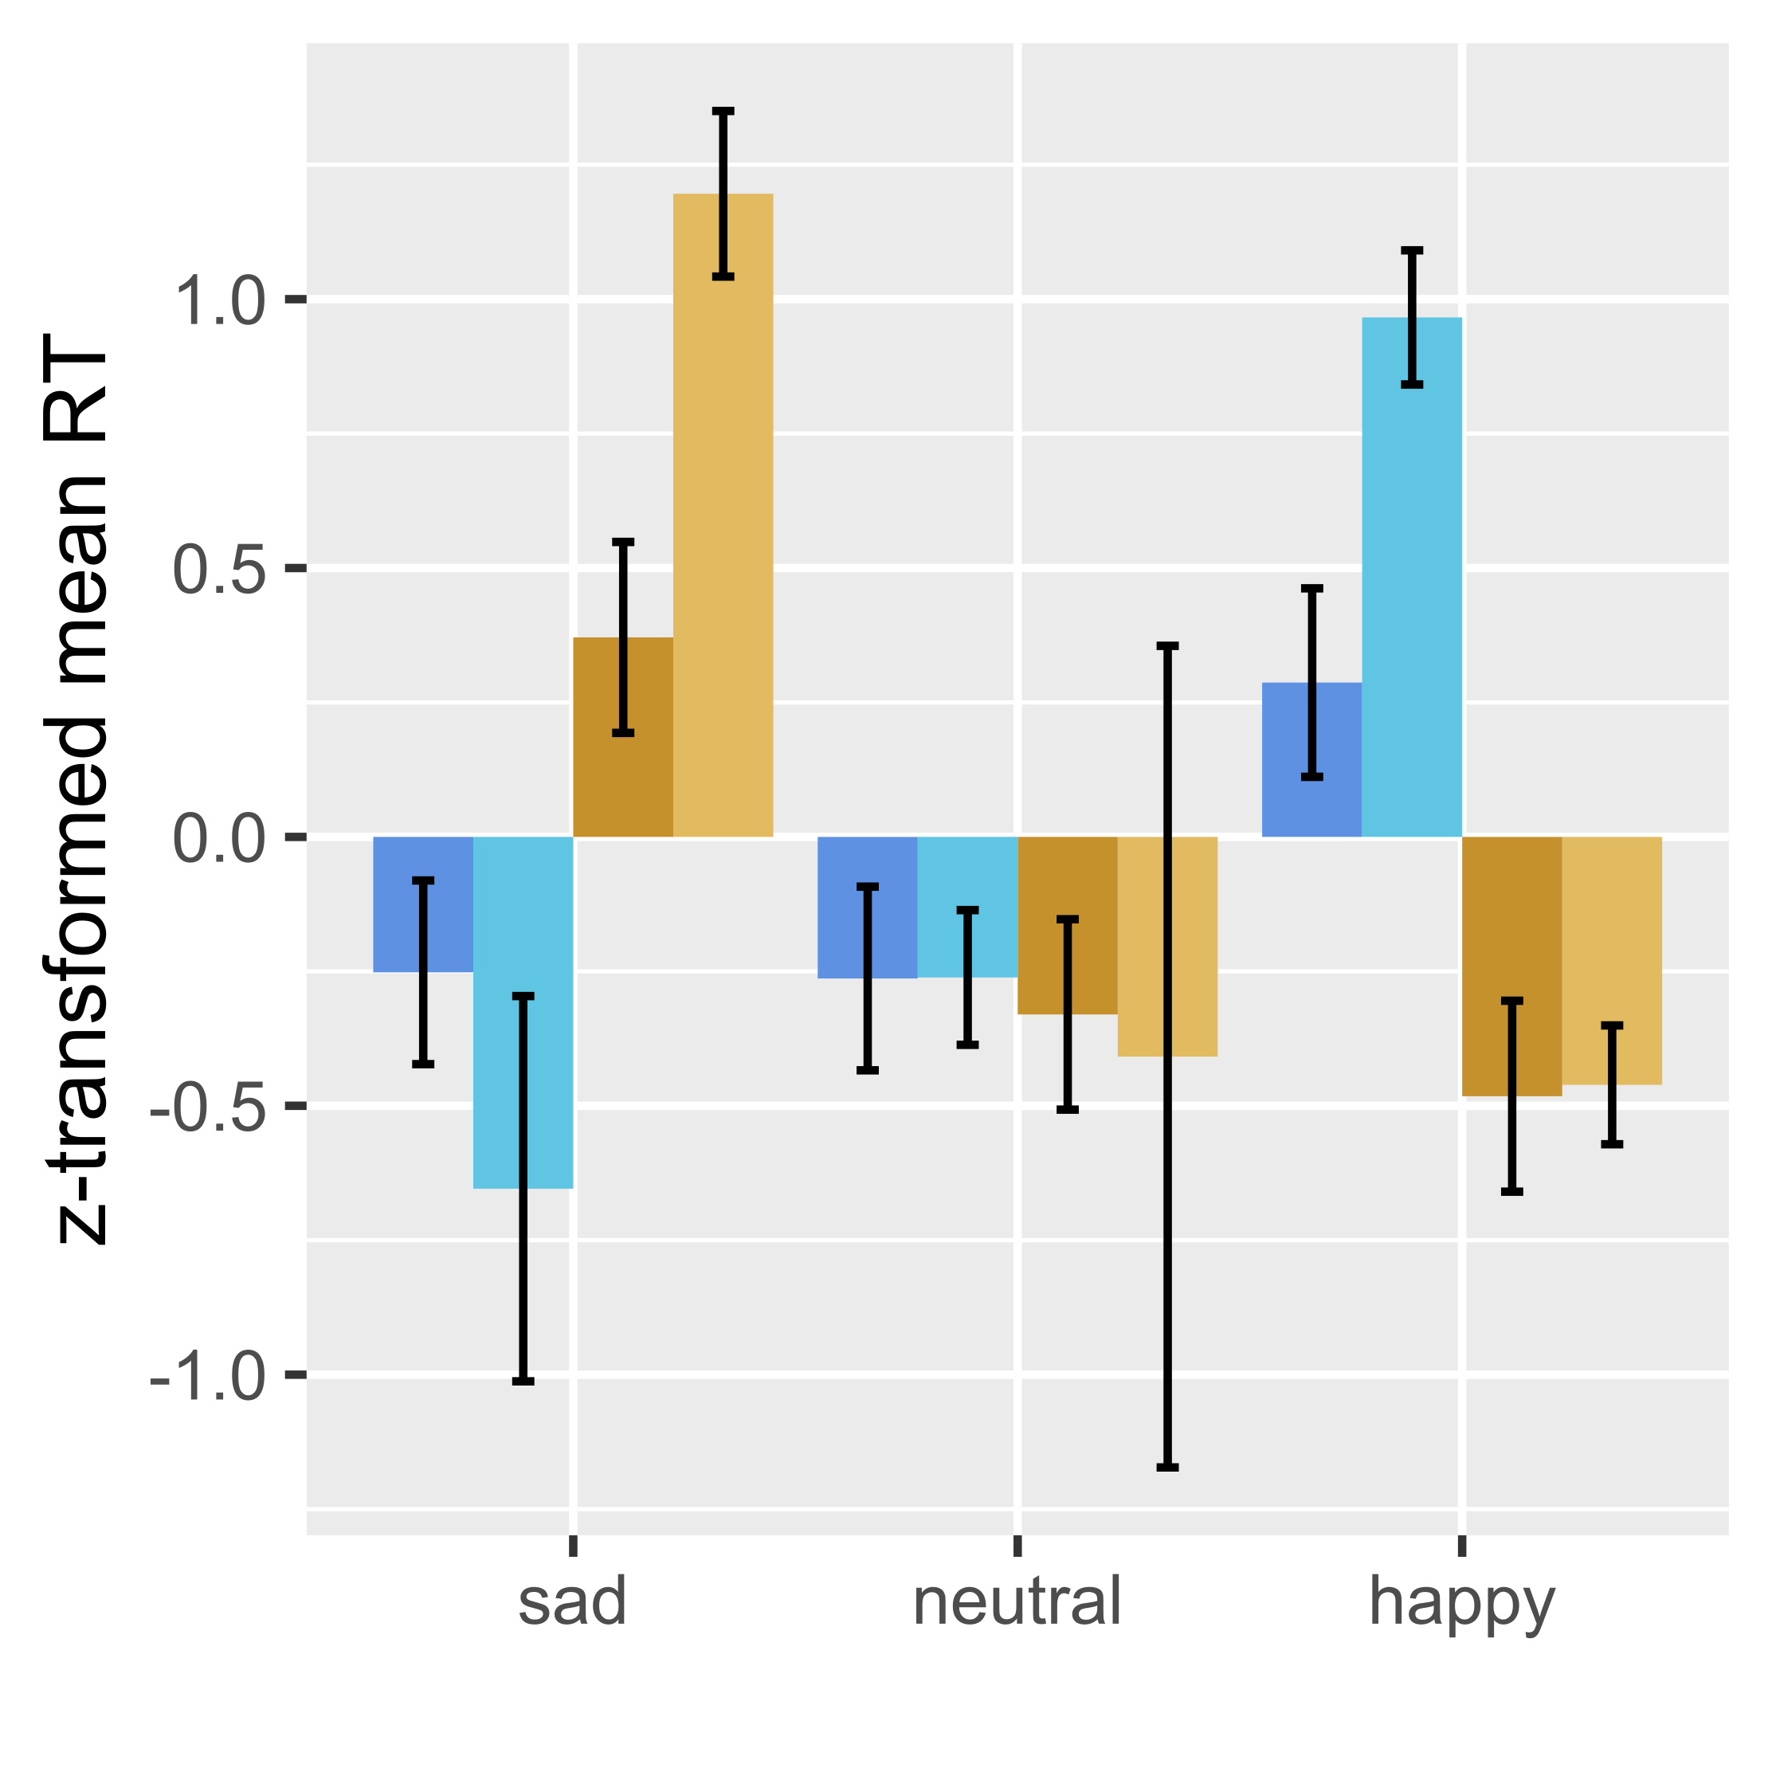
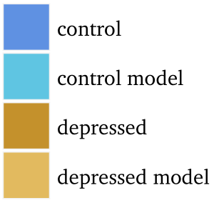
Slower disengagement from mood-congruent items
0-back | 1-back | 2-back
neutral | happy | sad

Slide 12
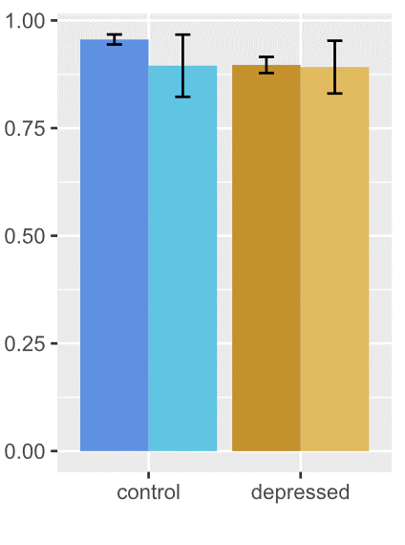
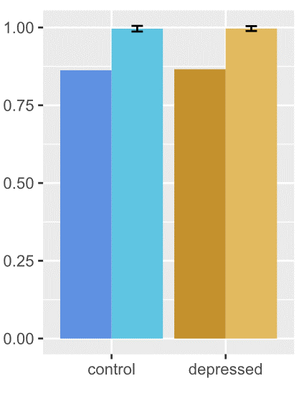
Response rate
Accuracy

Slide 13
Summary
Cognitive models can help us understand rumination
We can implement and test verbal theories
Contents of memory
Valence-specific biases in WM updating
We can make testable predictions about behaviour
Response time, accuracy, response rate
Occurrence of rumination

