Slide 1
Modelling the Effect of Depression on Working Memory
Maarten van der Velde, Marieke van Vugt, Niels Taatgen
University of Groningen
m.a.van.der.velde@rug.nl
@mavdvelde

Slide 2
Depression affects cognition
Notes:
Depression is an important mental health issue that does not only affect our emotional state but also our cognitive performance. For example, working memory performance is negatively affected, and especially when emotional material is involved.

Slide 3
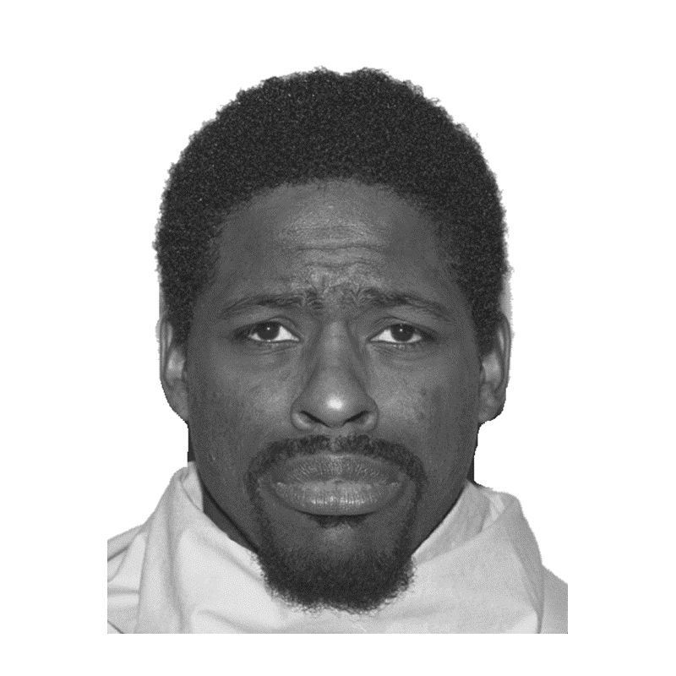
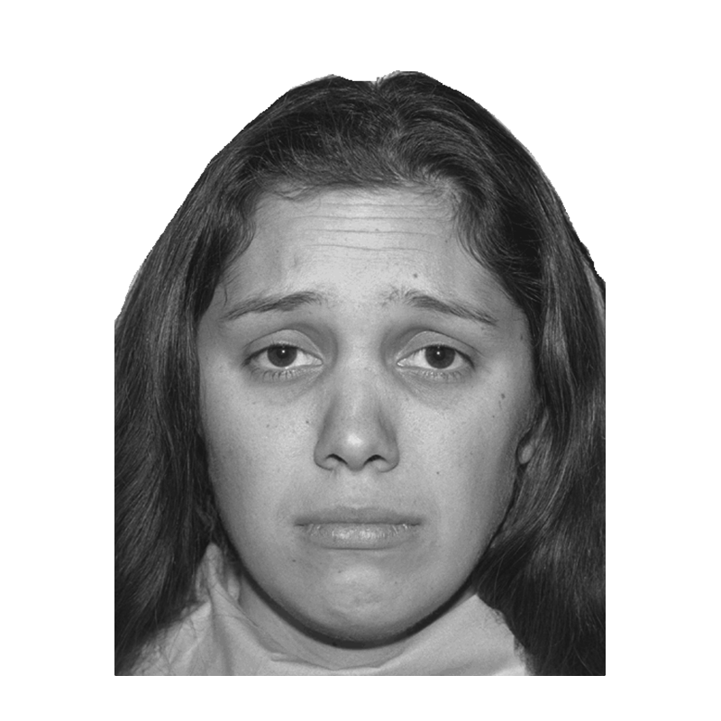
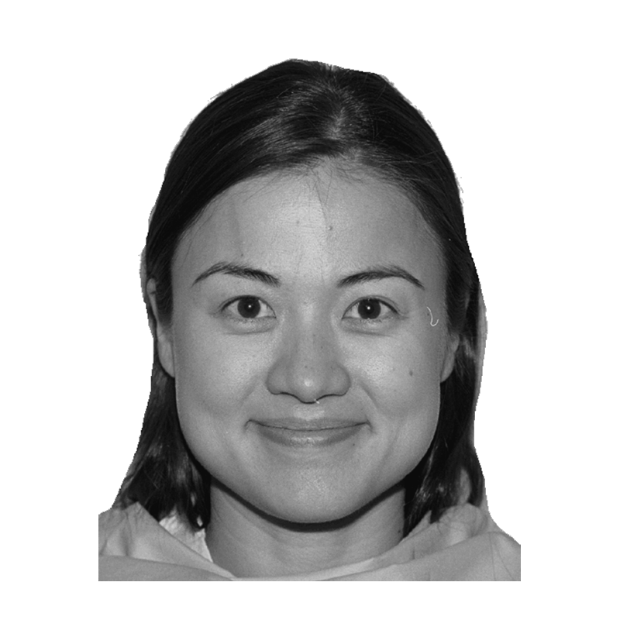
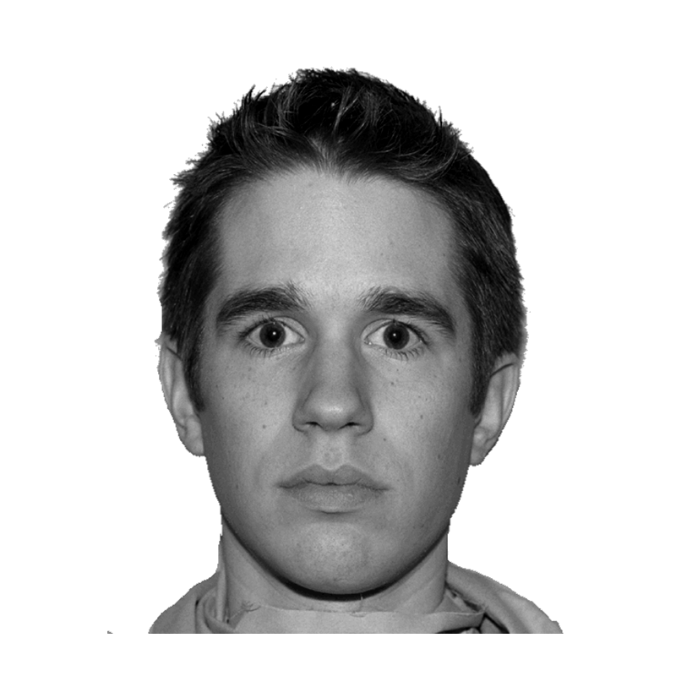
Emotional n-back task
Levens, S. M., & Gotlib, I. H. (2010). Updating positive and negative stimuli in working memory in depression. Journal of Experimental Psychology: General, 139(4), 654.
+
Notes:
We have modelled how depression affects performance of participants in this task: the emotional n-back task, an n-back in which the stimuli are faces with some emotional expression. Sara Levens and Ian Gotlib let depressed and healthy participants do this task and compared their performance. In general, depressed participants did the task about as well as those without depression, but there were some differences in specific conditions of the task.

Slide 4
Emotional 0-back
Levens & Gotlib (2010)
target: neutral
different
different
different
same
different
Notes:
We modelled two versions of the task, a 0-back and a 2-back. I'll focus on the 0-back first. In this task, participants were asked to compare the expression of the current face to a target that they were given earlier (for example, here they determine for each face whether it has a neutral expression).

Slide 5
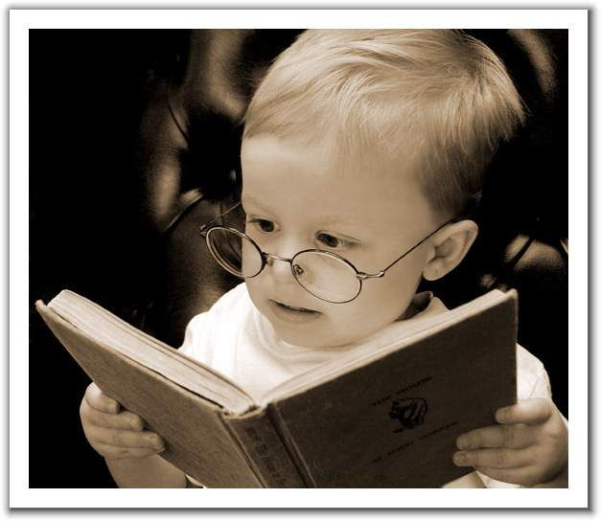
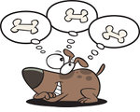
0-back model
PRIMs: www.ai.rug.nl/~niels/actransfer.html
Goal:
Task
Goal:
Wander
Competition
Notes:
The model was made in PRIMs, a cognitive architecture that is similar to ACT-R, but allows us to model competition between goals more flexibly. This is useful, because our model has two goals: a "task" goal that represents doing the task, and a "wander" goal that represents any off-task thought, such as mind-wandering or rumination.

Slide 6
0-back model: task goal active
?
declarative memory
expression: sad
goal
target: sad
match
press same
Notes:
This is what the process of doing the task looks like in the model. A target expression is held in the goal buffer. The model sees a new face appear, deciphers its expression--we model this as a retrieval from declarative memory--and does a comparison betwee the two. In this case the face matches the target expression, so the model presses the "same" key.

Slide 7
0-back model: wander goal active
retrieve random memory
place memory in imaginal buffer
declarative memory
memory X
See van Vugt et al. (2015; 2018), Taatgen et al. (2015)
Notes:
Because it is virtually impossible to be 100% focused on a task (especially when it is long and tedious) the model also has a "wander" goal that is dedicated to off-task thinking. This idea will be familiar to you if you have seen previous work by Marieke van Vugt and others on modelling mind-wandering. Mind-wandering starts spontaneously, and consists of a so-called "thought pump", in which the model repeatedly retrieves random items from its memory. When the model is mind-wandering, it is not doing the task, so we expect it to respond more slowly or miss responses altogether.

Slide 8
0-back model: modelling depression
More mind-wandering / rumination
Increased activation of wander goal
Psychomotor slowing
Slower keypress
Notes:
Remember that we are not just interested in modelling performance on this task, but in particular how performance is affected when participants are depressed. To model the cognitive effects of depression, we referred to common findings in the depression literature:
- We know that people with depression engage in more mind-wandering, and especially in more negatively themed and persistent rumination. By strengthening the off-task goal in the depressed version of the model, we expect it to respond less frequently on the task.
- Furthermore, a common finding is that depression causes psychomotor slowing, so the depressed version of our model has a slower keypress.

Slide 9
0-back model captures behavioural differences
Response rate
Response time (s)
Accuracy
RMSE = .01
RMSE = .04
RMSE = .07
Notes:
The plots compare the model fit to the data. They show that the model fits the patterns in the data quite well: the depressed model responds less often, takes longer to respond, and has similar accuracy (although both versions of the model do make fewer errors than humans).

Slide 10
Emotional 2-back
Levens & Gotlib (2010)
n
n + 1
n + 2 same
n + 3 different
n + 4 different
Notes:
The second version of the task that we modelled was a 2-back, in which participants report whether the emotional expression of the current face is the same as the expression of the face two trials back. Compared to the 0-back, the 2-back relies more heavily on working memory.

Slide 11
2-back model: task goal active
?
declarative memory
expression: sad
working memory
0-back | 1-back | 2-back
happy
sad
sad
neutral
match
press same
Notes:
The 2-back model is very similar to the 0-back model, but instead of the comparison to the target in the goal buffer, the model keeps and continuously updates a list of the most recent stimuli in working memory. When a new stimulus appears, its expression is identified in the same way as before, but now it is added to the front of list. All other items in the list get shifted back by one place. The oldest item drops off the list since it is no longer relevant to the task. Now the model compares the current stimulus with the 2-back item and responds accordingly.

Slide 12
2-back model: modelling depression
Slower disengagement from sad items
Control model lingers on happy items instead
elaborate
depressed
model
0-back | 1-back | 2-back
sad
control model
0-back | 1-back | 2-back
sad
Notes:
Once again, we want to model the effect of depression on this task. The behavioural results from Levens & Gotlib showed that there was an effect of the stimulus that was pushed off the mental list: whenever depressed participants had to get rid of a sad stimulus from their mental list, their subsequent response was slower than when they had to forget a neutral or happy item. We think this may be caused by mood-congruent elaboration: the item activates related concepts and memories that slow down the task process. We represented this in the model as an "elaborate" operator, which spends some time lingering on sad stimuli--but not on others--as they are pushed off the list.
Levens & Gotlib found the reverse effect too: non-depressed participants were slower when discarding a happy stimulus. So the nondepressed version of the model does the same kind of elaboration, but on happy items.

Slide 13
2-back model: modelling depression
Faster integration of sad items
Perceptual bias (higher chunk activation)
depressed
model
0-back | 1-back | 2-back
sad
control model
0-back | 1-back | 2-back
sad
Notes:
Depressed participants also responded more quickly when integrating a sad stimulus into their mental list, which we model with a perceptual bias towards sad stimuli.

Slide 14
2-back model: modelling depression
More mind-wandering / rumination
Increased activation of wander goal
Psychomotor slowing
Slower keypress
Biased treatment of negative items in WM
Faster integration
Slower disengagement (elaboration)
Notes:
To summarise, we model the effects of depression on the 2-back task by increasing the tendency for off-task thinking and by slowing down the motor response (this is the same as in the 0-back model). In addition, the depressed model has a biased treatment of negative items in working memory: they are integrated more quickly and disengaged from more slowly.

Slide 15
2-back model also captures behavioural differences
Response rate
Response time (s)
Accuracy
RMSE = .04
RMSE = .01
RMSE = .09
Notes:
Here the model fit is compared to the data. Once again, the model reproduces the effects in the data quite well: the depressed model has a lower response rate and higher response times. The accuracy is a bit off though.

Slide 16
Model replicates faster integration of sad stimuli
0-back | 1-back | 2-back
Notes:
This plot shows that the model successfully captures the relatively fast integration of sad stimuli into working memory. Response times are z-transformed to factor out the overall slowness of responses by the depressed participants and model.

Slide 17
Model replicates slower disengagement from mood-congruent stimuli
0-back | 1-back | 2-back
Notes:
Both depressed and non-depressed participants slowed down in trials in which a mood-congruent stimulus had to be discarded from their mental list. This plot shows that the model is able to replicate this effect as well.

Slide 18
Modelling the effect of depression on working memory
Model offers explanation for observed effects
Stronger mind-wandering → lower response rate
Slower motor actions → higher response time
Negative bias → emotion-specific RT effects
Materials: github.com/maartenvandervelde/emotional-n-back
Comments: m.a.van.der.velde@rug.nl / @mavdvelde
Thank you!
Notes:
In conclusion, we have shown a model of the effects of depression on working memory that can explain behavioural effects found in humans through a set of mechanisms motivated by literature: stronger mind-wandering causes fewer responses, psychomotor slowing causes higher response times, and emotion-specific biases in integrating and discarding information from working memory causes RT effects in a particular set of conditions.

Slide 20
More plots…

Slide 21
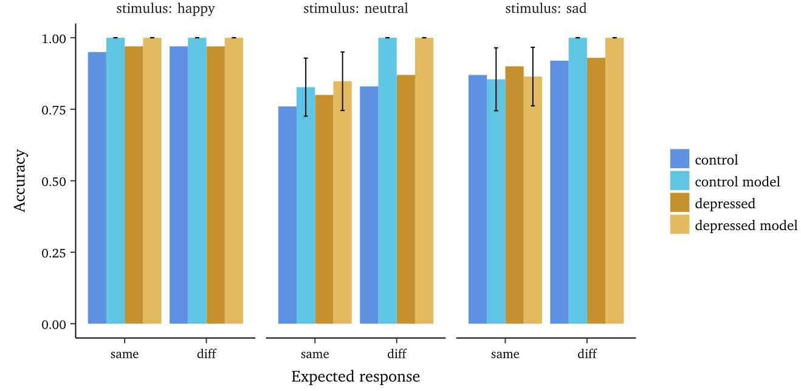
Notes:
0-back accuracy by condition

Slide 22
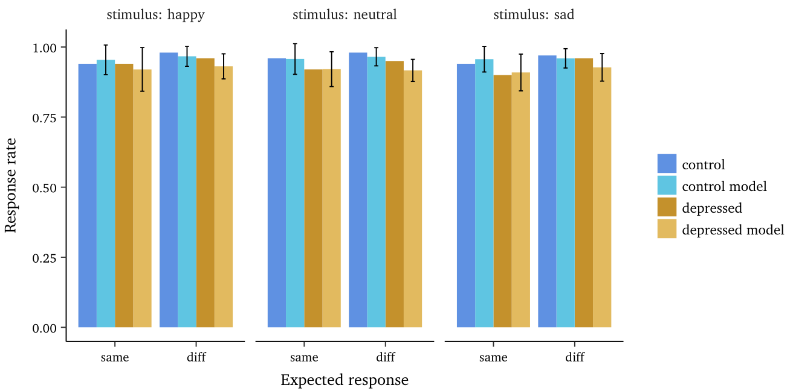
Notes:
0-back response rate by condition

Slide 23
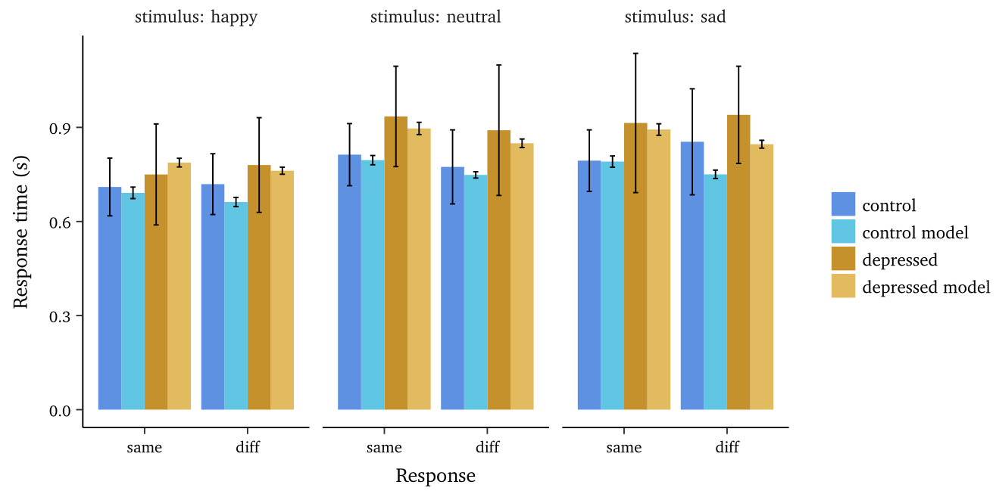
Notes:
0-back RT by condition

Slide 24
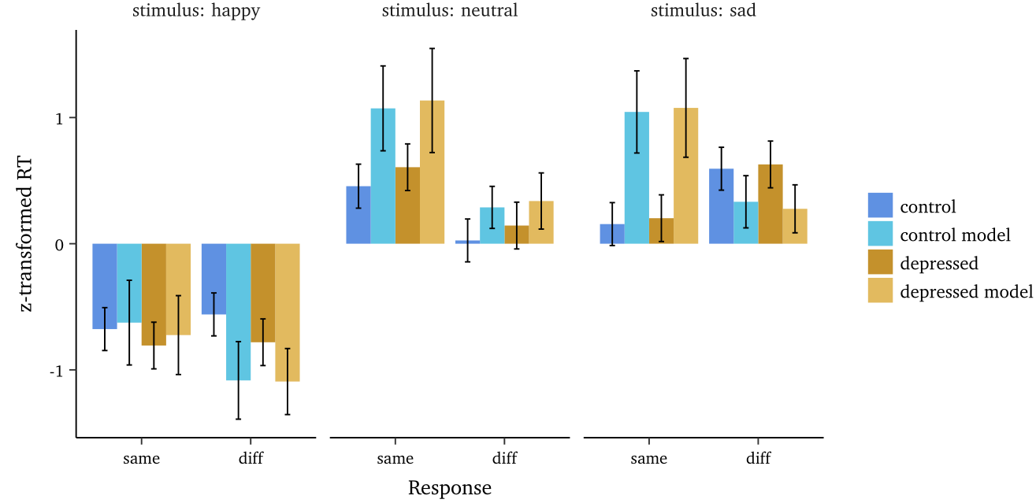
Notes:
0-back z-RT by condition

Slide 25
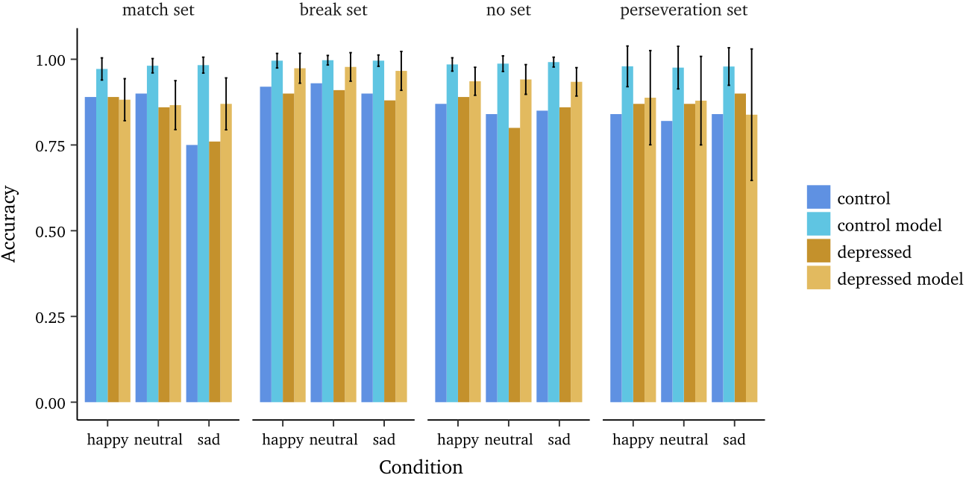
Notes:
2-back accuracy by condition

Slide 26
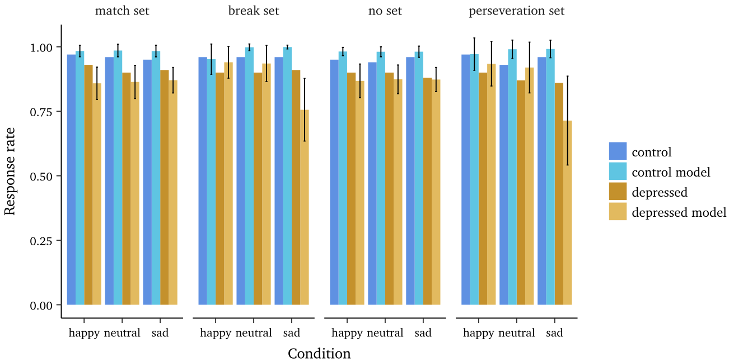
Notes:
2-back response rate by condition

Slide 27
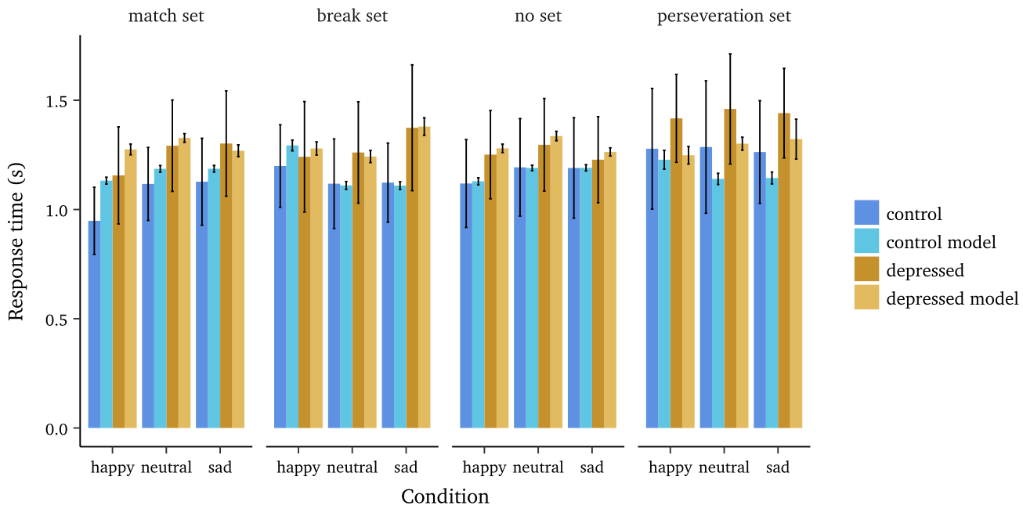
Notes:
2-back response time by condition

Slide 28
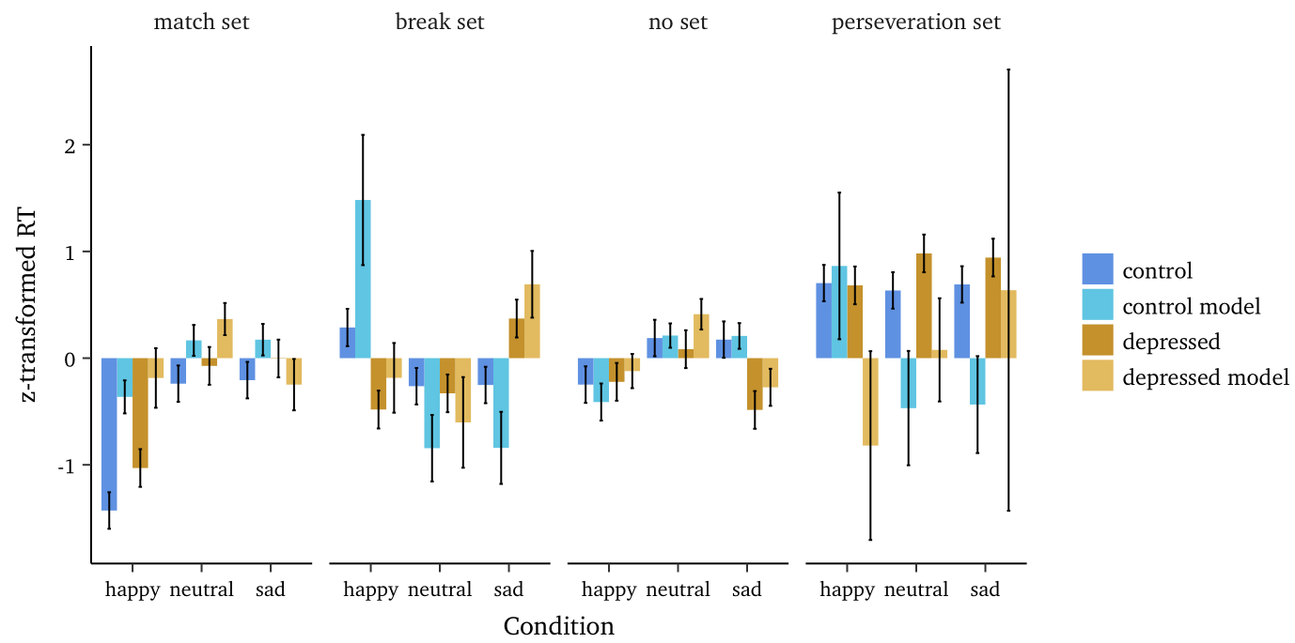
Notes:
2-back z-RT by condition

